Slide 1
AI Website
Version 2

Slide 2


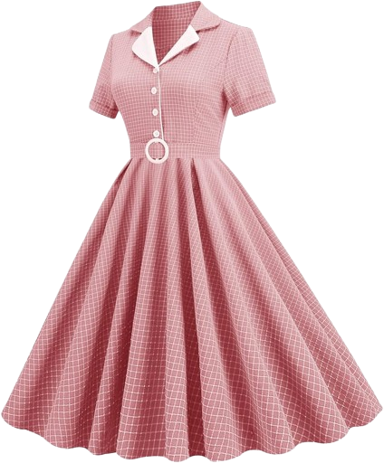
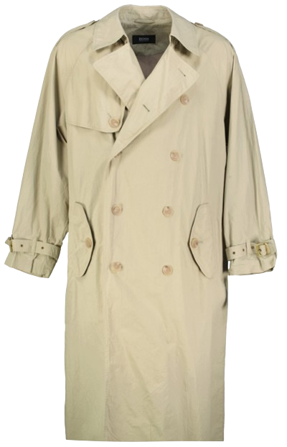



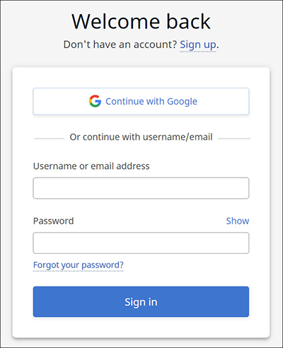
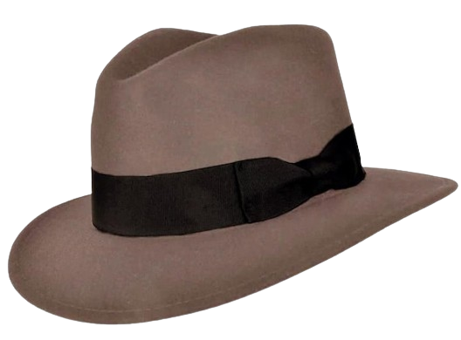
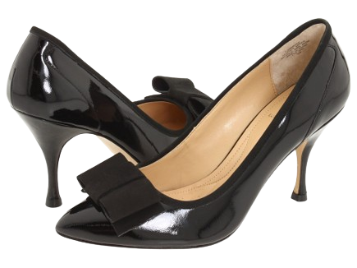
Notes:
This

Slide 3
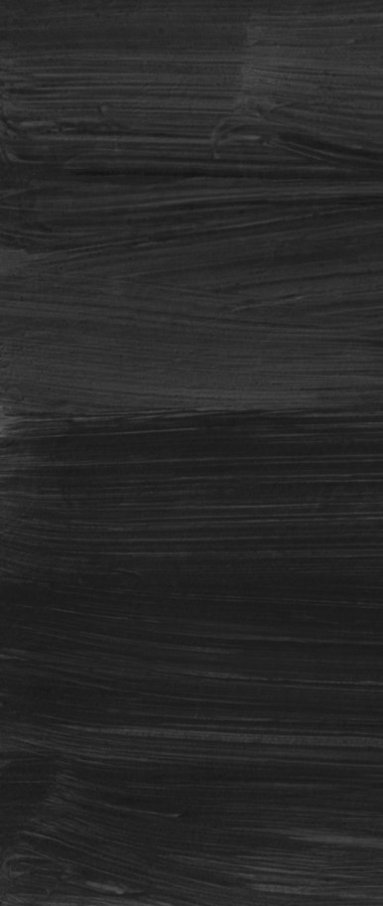
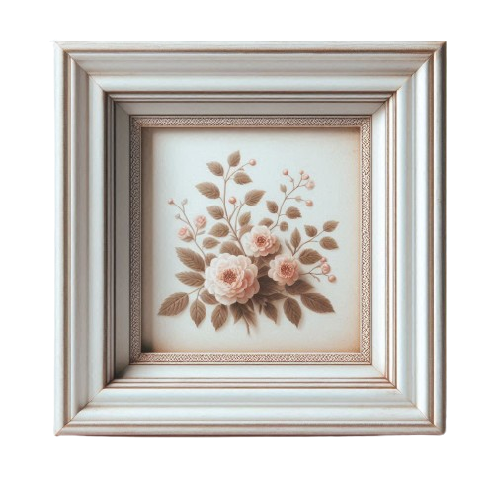


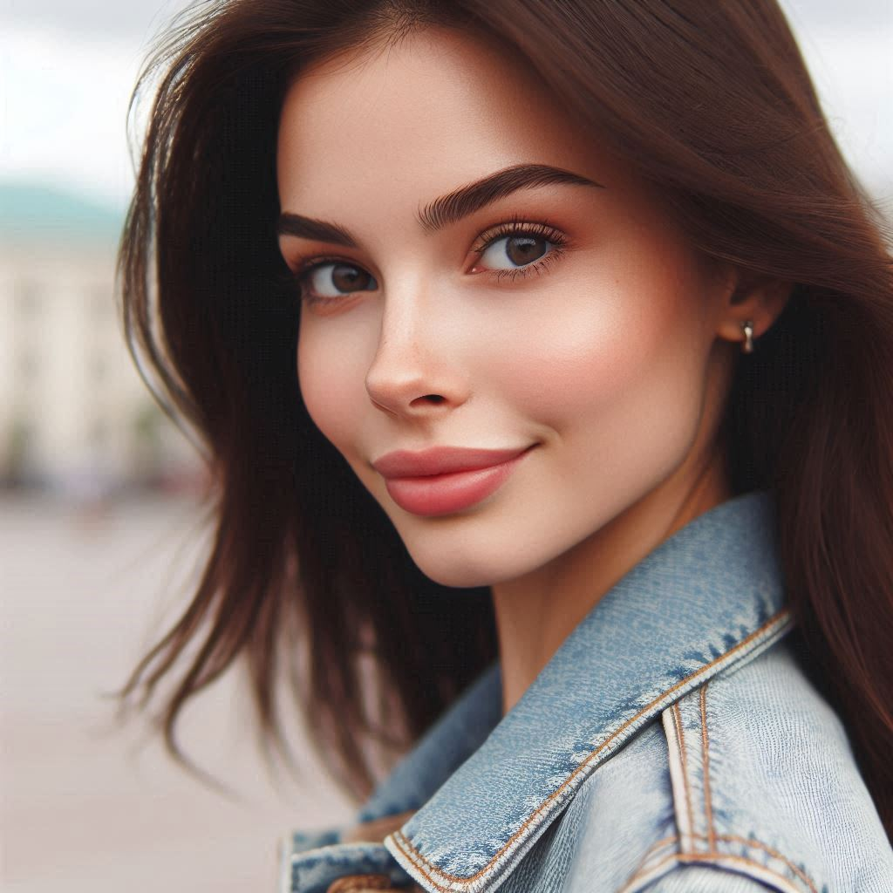
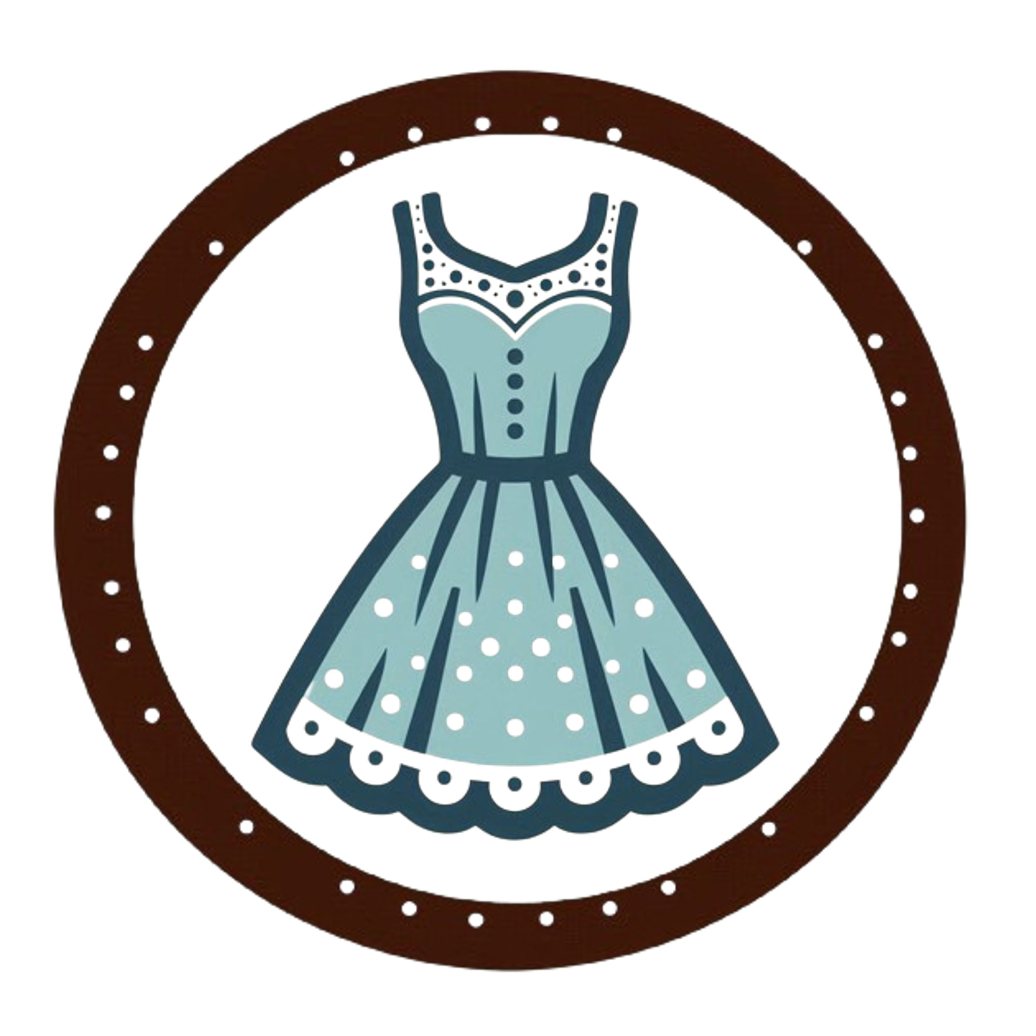


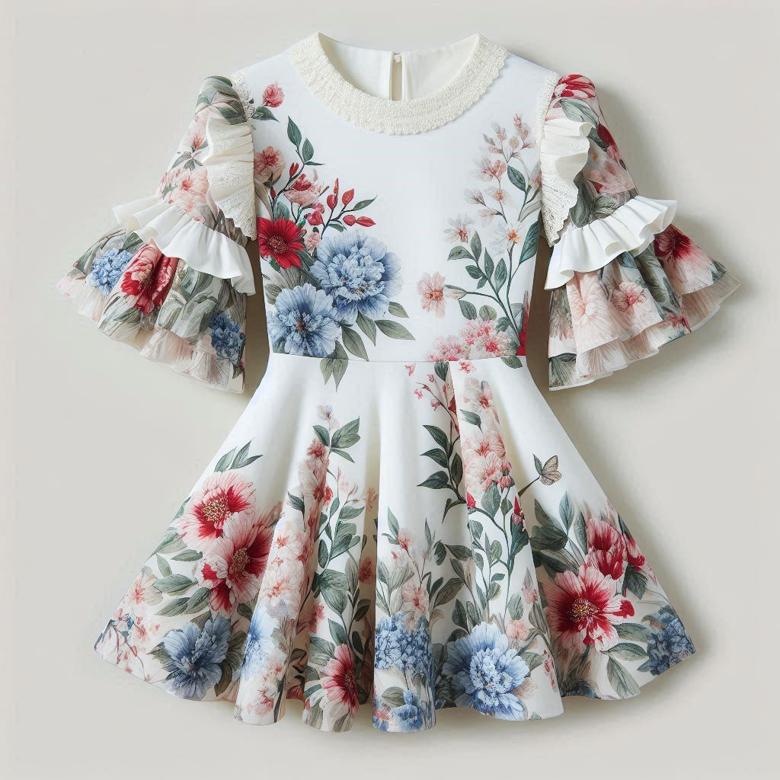








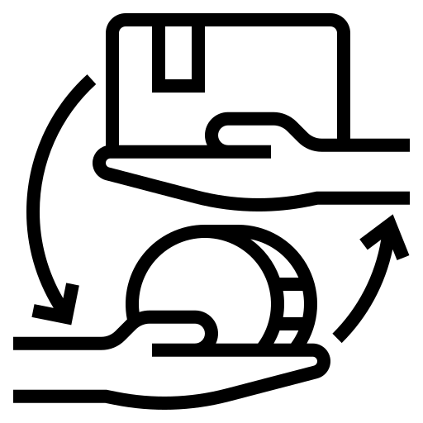





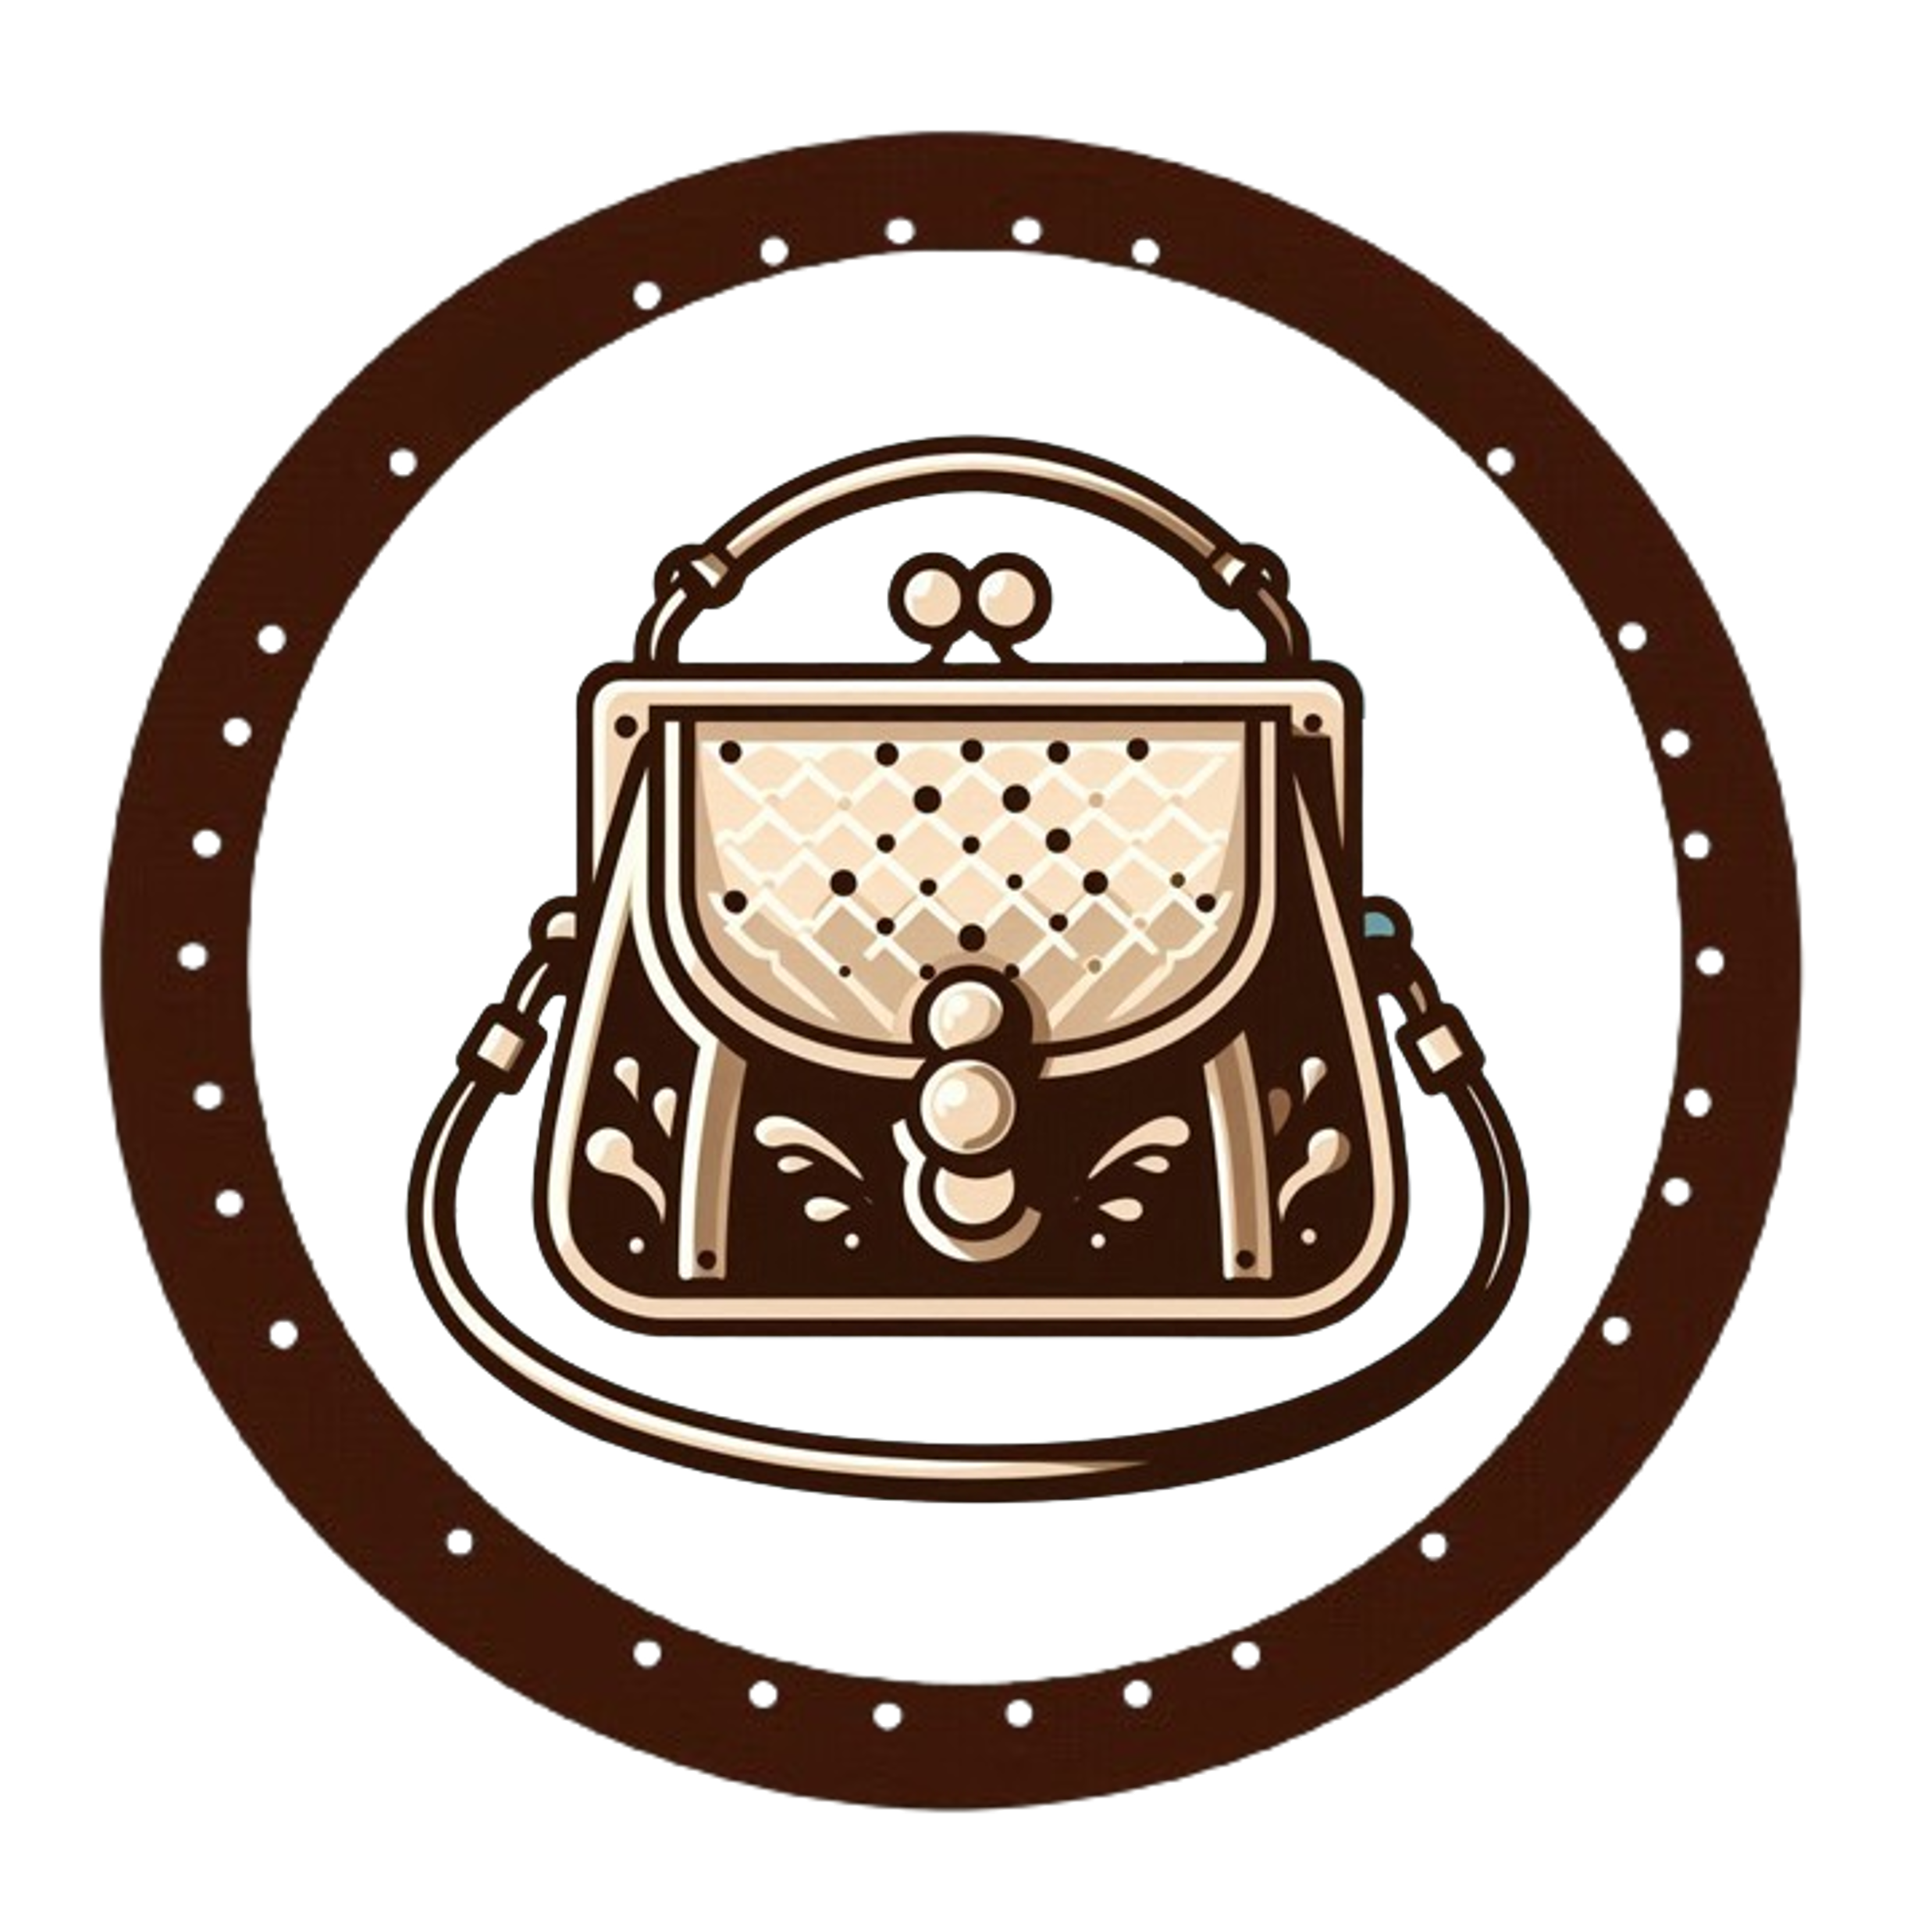

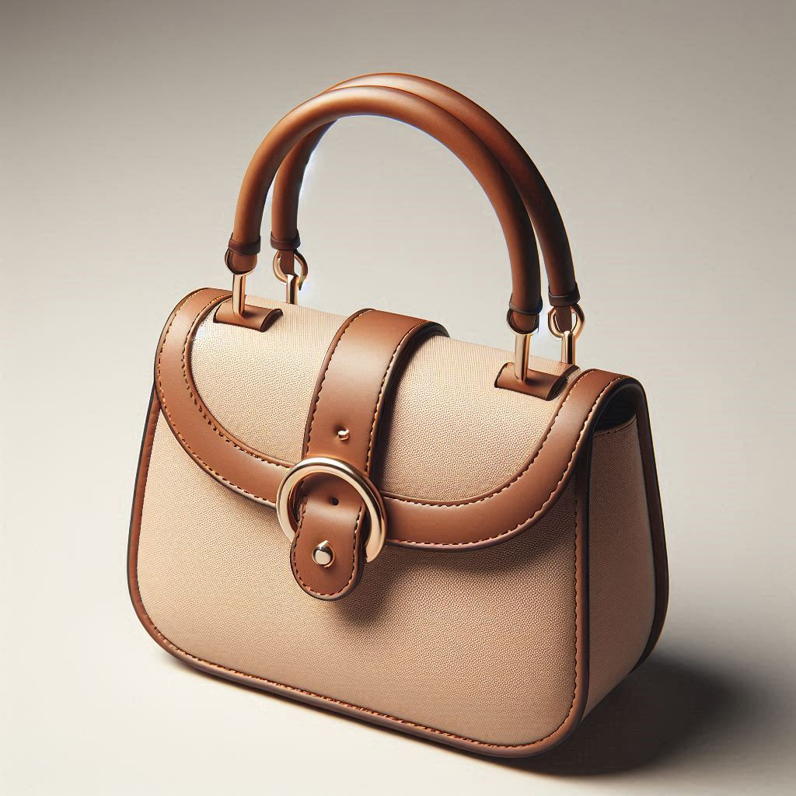

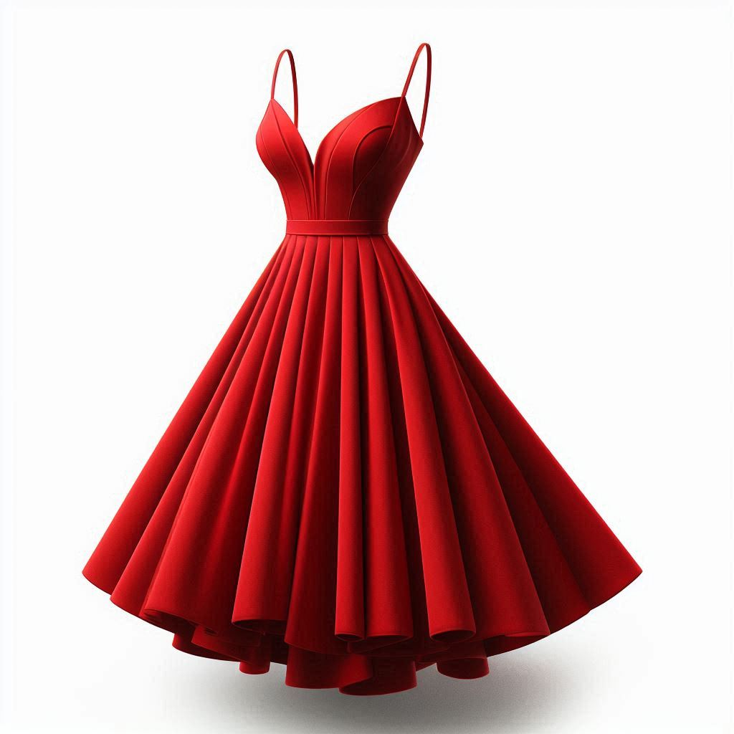
I’m looking for… some shoes for a night out
Personal Fit
Featured Feeds
Most Wishlisted
Laurie
Home
Top Brands
Clothing Items
Wishlist & History
Great Deals
Shopping Cart
Spring Vogue
Sell your Items
80% OFF + 18 MSI
HOT SALE ALERT !
About us
© 2024 VINTAGE VOGUE
Our locations
White floral dress by Zara with decorative bl
UP TO
More…
50
*Conditions apply
Small and elegant purse by Dasein with metal
More…
17
White floral dress by Zara with decorative bl
More…
71
Notes:
This is a mockup of what the final design would look like.

Slide 4

I’m looking for… some shoes for a night out
Personal Fit
Featured Feeds
Most Wishlisted
Laurie
Home
Top Brands
Clothing Items
Wishlist & History
Great Deals
Shopping Cart
Spring Vogue
Sell your Items
80% OFF + 18 MSI
HOT SALE ALERT !
About us
© 2024 VINTAGE VOGUE
Our locations
White floral dress by Zara with decorative bl
UP TO
More…
50
*Conditions apply
Small and elegant purse by Dasein with metal
More…
17
White floral dress by Zara with decorative bl
More…
71
Notes:
This is a mockup of what the final design would look like.

Slide 5
I’m looking for… some shoes for a night out
Personal Fit
Featured Feeds
Most Wishlisted
Laurie
Home
Top Brands
Clothing Items
Wishlist & History
Great Deals
Shopping Cart
Spring Vogue
Sell your Items
80% OFF + 18 MSI
HOT SALE ALERT !
About us
© 2024 VINTAGE VOGUE
Our locations
UP TO
*Conditions apply
Notes:
One of the main features of this website is that it can show items on their feed personalized their own measurements.

Slide 6
I’m looking for… some shoes for a night out
Personal Fit
Featured Feeds
Most Wishlisted
Laurie
Home
Top Brands
Clothing Items
Wishlist & History
Great Deals
Shopping Cart
Spring Vogue
Sell your Items
80% OFF + 18 MSI
HOT SALE ALERT !
About us
© 2024 VINTAGE VOGUE
Our locations
White floral dress by Zara with decorative bl
UP TO
More…
50
*Conditions apply
Small and elegant purse by Dasein with metal
More…
17
White floral dress by Zara with decorative bl
More…
71
Notes:
This is a mockup of what the final design would look like.

Slide 7
White floral dress by Zara with decorative bl
I’m looking for… some shoes for a night out
More…
50
Personal Fit
Featured Feeds
Most Wishlisted
Laurie
Home
Top Brands
Clothing Items
Wishlist & History
Great Deals
Shopping Cart
Spring Vogue
Sell your Items
80% OFF + 18 MSI
HOT SALE ALERT !
About us
© 2024 VINTAGE VOGUE
Our locations
Small and elegant purse by Dasein with metal
UP TO
More…
17
*Conditions apply
White floral dress by Zara with decorative bl
More…
71
Notes:
The customers can immediately notice that they can scroll down the website to look at each of the items

Slide 8
White floral dress by Zara with decorative bl
More…
50
Small and elegant purse by Dasein with metal
I’m looking for… some shoes for a night out
More…
17
Personal Fit
Featured Feeds
Most Wishlisted
Laurie
Home
Top Brands
Clothing Items
Wishlist & History
Great Deals
Shopping Cart
Spring Vogue
Sell your Items
80% OFF + 18 MSI
HOT SALE ALERT !
About us
© 2024 VINTAGE VOGUE
Our locations
White floral dress by Zara with decorative bl
UP TO
More…
71
*Conditions apply
Notes:
This is a mockup of what the final design should look like.

Slide 9
White floral dress by Zara with decorative bl
More…
50
Small and elegant purse by Dasein with metal
I’m looking for… some shoes for a night out
More…
17
Personal Fit
Featured Feeds
Most Wishlisted
Laurie
Home
Top Brands
Clothing Items
Wishlist & History
Great Deals
Shopping Cart
Spring Vogue
Sell your Items
80% OFF + 18 MSI
HOT SALE ALERT !
About us
© 2024 VINTAGE VOGUE
Our locations
White floral dress by Zara with decorative bl
UP TO
More…
71
*Conditions apply
Notes:
This is a mockup of what the final design should look like.

Slide 10
White floral dress by Zara with decorative bl
More…
50
Small and elegant purse by Dasein with metal
I’m looking for… some shoes for a night out
More…
17
Personal Fit
Featured Feeds
Most Wishlisted
Laurie
Home
Top Brands
Clothing Items
Women
Men
Wishlist & History
Great Deals
Shopping Cart
Spring Vogue
Sell your Items
80% OFF + 18 MSI
HOT SALE ALERT !
About us
© 2024 VINTAGE VOGUE
Our locations
White floral dress by Zara with decorative bl
UP TO
More…
71
*Conditions apply
Notes:
This is a mockup of what the final design should look like.

Slide 11
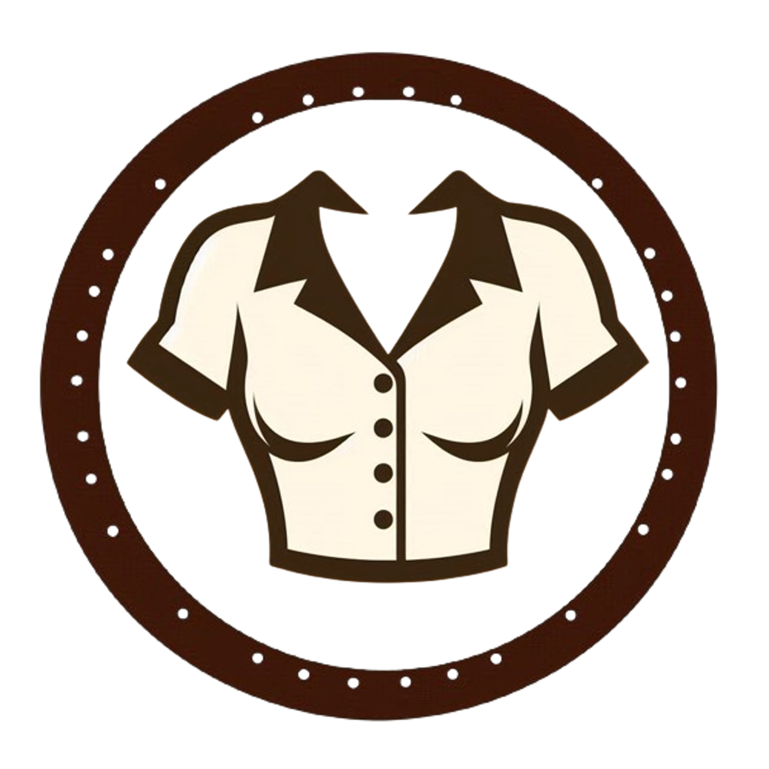



I’m looking for… some shoes for a night out
Women’s Catalogue
Featured Feeds
Most Wishlisted
Laurie
Home
Top Brands
Clothing Items
Blouses
Dresses
Wishlist & History
Great Deals
Shopping Cart
Spring Vogue
Sell your Items
80% OFF + 18 MSI
Heels
Purses
HOT SALE ALERT !
About us
© 2024 VINTAGE VOGUE
Our locations
UP TO
*Conditions apply
Skirts
Sunhats
Notes:
This is a mockup of what the final design should look like.

Slide 12
I’m looking for… some shoes for a night out
Women’s Catalogue
Featured Feeds
Blouses
Dresses
Most Wishlisted
Laurie
Home
Top Brands
Clothing Items
Wishlist & History
Great Deals
Heels
Purses
Shopping Cart
Spring Vogue
Sell your Items
80% OFF + 18 MSI
HOT SALE ALERT !
About us
© 2024 VINTAGE VOGUE
Our locations
UP TO
Skirts
Sunhats
*Conditions apply
Notes:
This is a mockup of what the final design should look like.

Slide 13
I’m looking for… some shoes for a night out
Women’s Catalogue
Featured Feeds
Blouses
Dresses
Most Wishlisted
Laurie
Home
Top Brands
Clothing Items
Wishlist & History
Great Deals
Heels
Purses
Shopping Cart
Spring Vogue
Sell your Items
80% OFF + 18 MSI
HOT SALE ALERT !
About us
© 2024 VINTAGE VOGUE
Our locations
UP TO
Skirts
Sunhats
*Conditions apply
Notes:
This is a mockup of what the final design should look like.

Slide 14
I’m looking for… some shoes for a night out
Personal Fit
Featured Feeds
Most Wishlisted
Laurie
Home
Top Brands
Clothing Items
Wishlist & History
Great Deals
Shopping Cart
Spring Vogue
Sell your Items
80% OFF + 18 MSI
HOT SALE ALERT !
About us
© 2024 VINTAGE VOGUE
Our locations
Small and elegant purse by Dasein with metal
UP TO
More…
17
*Conditions apply
Notes:
This is a mockup of what the final design should look like.

Slide 15
I’m looking for… some shoes for a night out
Personal Fit
Featured Feeds
Most Wishlisted
Laurie
Home
Top Brands
Clothing Items
Wishlist & History
Great Deals
Shopping Cart
Spring Vogue
Sell your Items
80% OFF + 18 MSI
HOT SALE ALERT !
About us
© 2024 VINTAGE VOGUE
Our locations
Small and elegant purse by Dasein with metal
UP TO
More…
17
*Conditions apply
Notes:
This is a mockup of what the final design should look like.

Slide 16
I’m looking for… some shoes for a night out
Personal Fit
Featured Feeds
Most Wishlisted
Laurie
Home
Top Brands
Clothing Items
Wishlist & History
Great Deals
Shopping Cart
Spring Vogue
Sell your Items
80% OFF + 18 MSI
HOT SALE ALERT !
About us
© 2024 VINTAGE VOGUE
Our locations
UP TO
*Conditions apply
Notes:
Click on picture to zoom in to inspect item quality.
A link for an HD image. Standard image quality for posts.

Slide 17
I’m looking for… some shoes for a night out
Personal Fit
Featured Feeds
Most Wishlisted
Laurie
Home
Top Brands
Clothing Items
Wishlist & History
Great Deals
Shopping Cart
Spring Vogue
Sell your Items
80% OFF + 18 MSI
HOT SALE ALERT !
About us
© 2024 VINTAGE VOGUE
Our locations
Small and elegant purse by Dasein with metal
UP TO
More…
17
*Conditions apply

Slide 18
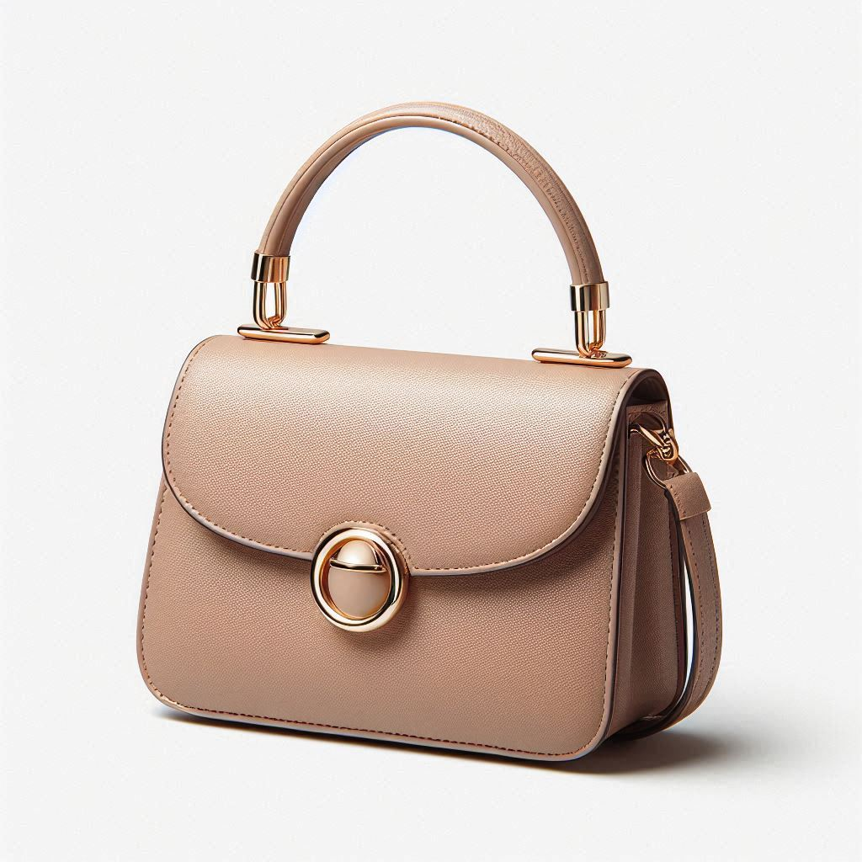
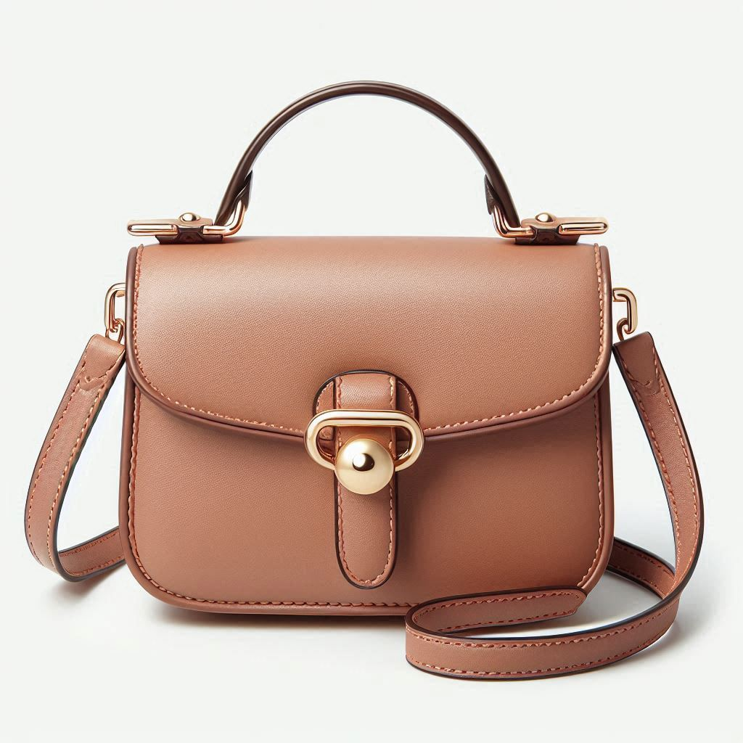
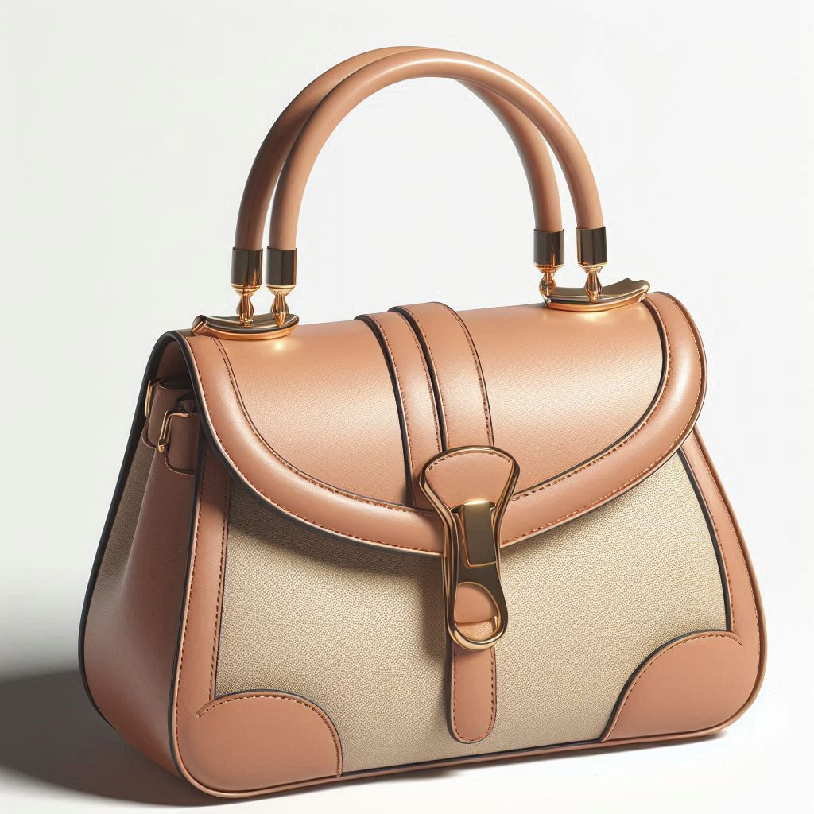
I’m looking for… some shoes for a night out
Personal Fit
Featured Feeds
Small and elegant purse by Dasein with metal clasp closure. The purse is made of a buttery soft, light brown leather with a beige colored accent panel on the front. It has a detachable gold chain strap which can be used to wear the purse as a crossbody bag or a clutch. The purse has a clean and minimalist design, making it perfect for day or evening wear.
Most Wishlisted
17
Laurie
Home
Top Brands
Clothing Items
Price: $28,000 $19,800
Wishlist & History
Great Deals
Follow
Women’s Purse
Shopping Cart
Follow
Dasein
Similar items:
Spring Vogue
Sell your Items
80% OFF + 18 MSI
HOT SALE ALERT !
About us
© 2024 VINTAGE VOGUE
Our locations
UP TO
*Conditions apply
Notes:
This is a mockup of what the final design should look like.

Slide 19
I’m looking for… some shoes for a night out
Personal Fit
Featured Feeds
Small and elegant purse by Dasein with metal clasp closure. The purse is made of a buttery soft, light brown leather with a beige colored accent panel on the front. It has a detachable gold chain strap which can be used to wear the purse as a crossbody bag or a clutch. The purse has a clean and minimalist design, making it perfect for day or evening wear.
Most Wishlisted
17
Laurie
Home
Top Brands
Clothing Items
Price: $28,000 $19,800
Wishlist & History
Great Deals
Follow
Women’s Purse
Shopping Cart
Follow
Dasein
Similar items:
Spring Vogue
Sell your Items
80% OFF + 18 MSI
HOT SALE ALERT !
About us
© 2024 VINTAGE VOGUE
Our locations
UP TO
*Conditions apply
Notes:
Original price is MSRP
Lower price is current price
User can follow/unfollow the clothing category and brand
Similar items require a frame outline

Slide 20
I’m looking for… some shoes for a night out
Personal Fit
Featured Feeds
Small and elegant purse by Dasein with metal clasp closure. The purse is made of a buttery soft, light brown leather with a beige colored accent panel on the front. It has a detachable gold chain strap which can be used to wear the purse as a crossbody bag or a clutch. The purse has a clean and minimalist design, making it perfect for day or evening wear.
Most Wishlisted
17
Laurie
Home
Top Brands
Clothing Items
Price: $28,000 $19,800
Wishlist & History
Great Deals
Follow
Women’s Purse
Shopping Cart
Follow
Dasein
Similar items:
Spring Vogue
Sell your Items
80% OFF + 18 MSI
HOT SALE ALERT !
About us
© 2024 VINTAGE VOGUE
Our locations
UP TO
*Conditions apply
Notes:
Change “shopping cart” icon color once clicked

Slide 21
I’m looking for… some shoes for a night out
Personal Fit
Featured Feeds
Small and elegant purse by Dasein with metal clasp closure. The purse is made of a buttery soft, light brown leather with a beige colored accent panel on the front. It has a detachable gold chain strap which can be used to wear the purse as a crossbody bag or a clutch. The purse has a clean and minimalist design, making it perfect for day or evening wear.
Most Wishlisted
17
Laurie
Home
Top Brands
Clothing Items
Price: $28,000 $19,800
Wishlist & History
Great Deals
Follow
Women’s Purse
Shopping Cart
Follow
Dasein
Similar items:
Spring Vogue
Sell your Items
80% OFF + 18 MSI
HOT SALE ALERT !
About us
© 2024 VINTAGE VOGUE
Our locations
UP TO
*Conditions apply
Notes:
Change “shopping cart” icon color once clicked

Slide 22
I’m looking for… some shoes for a night out
Personal Fit
Featured Feeds
Most Wishlisted
Laurie
Home
Top Brands
Clothing Items
Wishlist & History
Great Deals
Shopping Cart
Spring Vogue
Sell your Items
80% OFF + 18 MSI
HOT SALE ALERT !
About us
© 2024 VINTAGE VOGUE
Our locations
Small and elegant purse by Dasein with metal
UP TO
More…
17
*Conditions apply
Notes:
This is a mockup of what the final design should look like.

Slide 23
I’m looking for… some shoes for a night out
Personal Fit
Featured Feeds
Most Wishlisted
Laurie
Home
Top Brands
Clothing Items
Wishlist & History
Great Deals
Shopping Cart
Spring Vogue
Sell your Items
80% OFF + 18 MSI
HOT SALE ALERT !
About us
© 2024 VINTAGE VOGUE
Our locations
Small and elegant purse by Dasein with metal
UP TO
More…
17
*Conditions apply
Notes:
This is a mockup of what the final design should look like.

Slide 24
I’m looking for… some shoes for a night out
Personal Fit
Featured Feeds
Most Wishlisted
Laurie
Home
Top Brands
Clothing Items
Wishlist & History
Great Deals
Shopping Cart
Spring Vogue
Sell your Items
80% OFF + 18 MSI
HOT SALE ALERT !
About us
© 2024 VINTAGE VOGUE
Our locations
Small and elegant purse by Dasein with metal
UP TO
More…
17
*Conditions apply
Notes:
This is a mockup of what the final design should look like.

Slide 25
I’m looking for… some shoes for a night out
Personal Fit
Featured Feeds
Most Wishlisted
Laurie
Home
Top Brands
Clothing Items
Wishlist & History
Great Deals
Shopping Cart
Spring Vogue
Sell your Items
80% OFF + 18 MSI
HOT SALE ALERT !
About us
© 2024 VINTAGE VOGUE
Our locations
Small and elegant purse by Dasein with metal
UP TO
More…
18
*Conditions apply
Notes:
This is a mockup of what the final design should look like.

Slide 26
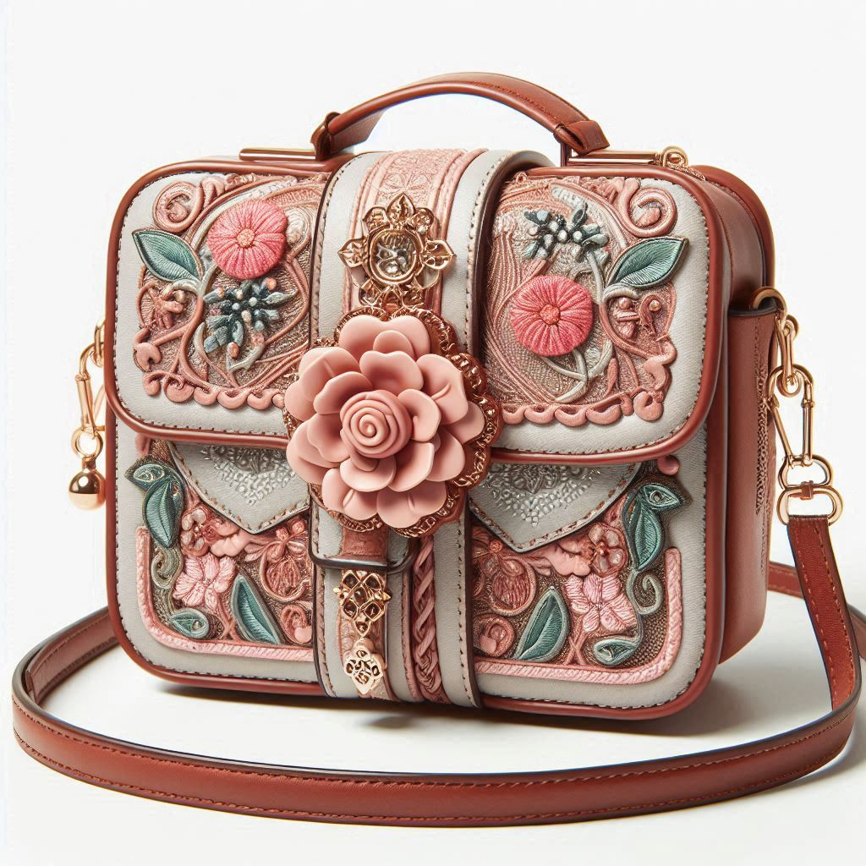
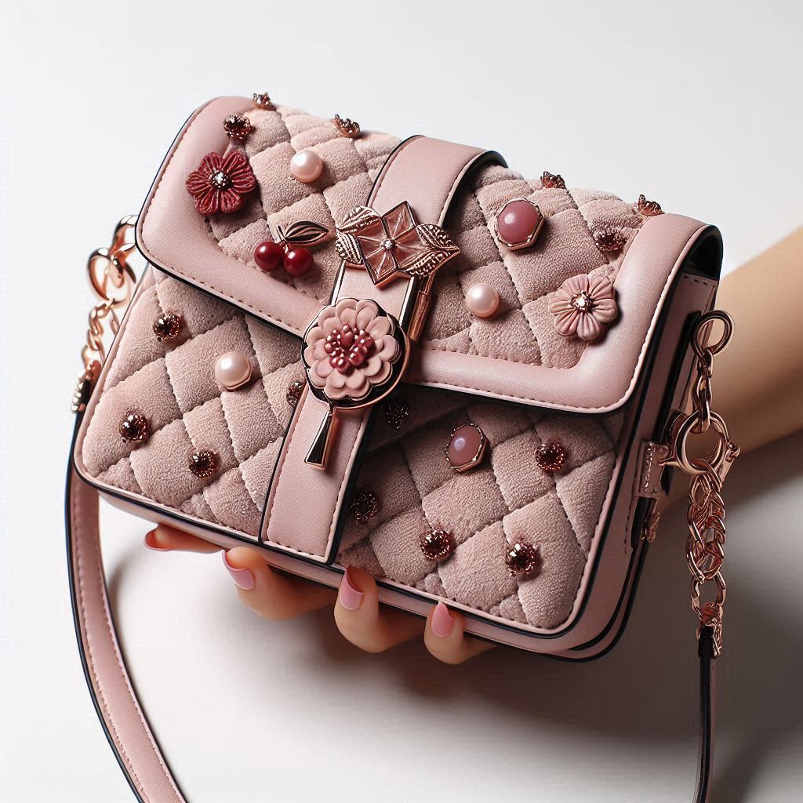
I’m looking for… some shoes for a night out
Personal Fit
Featured Feeds
Most Wishlisted
Laurie
Home
Top Brands
Clothing Items
Wishlist & History
Great Deals
Shopping Cart
Spring Vogue
Sell your Items
80% OFF + 18 MSI
HOT SALE ALERT !
About us
© 2024 VINTAGE VOGUE
Our locations
Small and elegant purse by Dasein with metal
UP TO
More…
18
*Conditions apply
Small and elegant purse by Dasein with metal
More…
42
Small and elegant purse by Dasein with metal
More…
42
Notes:
This is a mockup of what the final design should look like.

Slide 27
User queries

Slide 28
User queries ideas
What [items] do you have that are less than 5000?
I am looking for an outfit to use on the beach. -> Summer?
I’m looking for shoes for a night event.
I have an elegant dinner and want a complete new look.
Red dresses in my wishlist.
A dress with a flower pattern for Spring
I am looking for a Porsche
Default message when a search is unsuccessful.
→ Oops! Seems we don’t have that item. Modify your query and Try again!

Slide 29
System Design

Slide 31



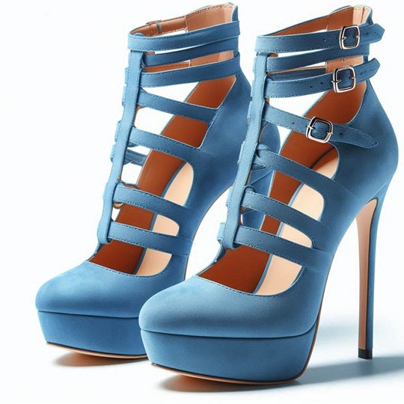


Categories
I’m looking for some shoes for a night out
Home Feed
Following
Most wanted
Hi, Laurie!
Home Feed
Closets
Settings
Most Popular Brands
Shopping Cart
Wishlist
Less than $5k
Sell your items
80% OFF + 18 MSI
HOT SALE ALERT !
Our locations
UP TO
Blue high heel shoes by Kurt Geiger made with
*Conditions apply
More…
127
Notes:
Home Feed: Personalized feed for the user, using their metadata to filter sizes

Slide 32
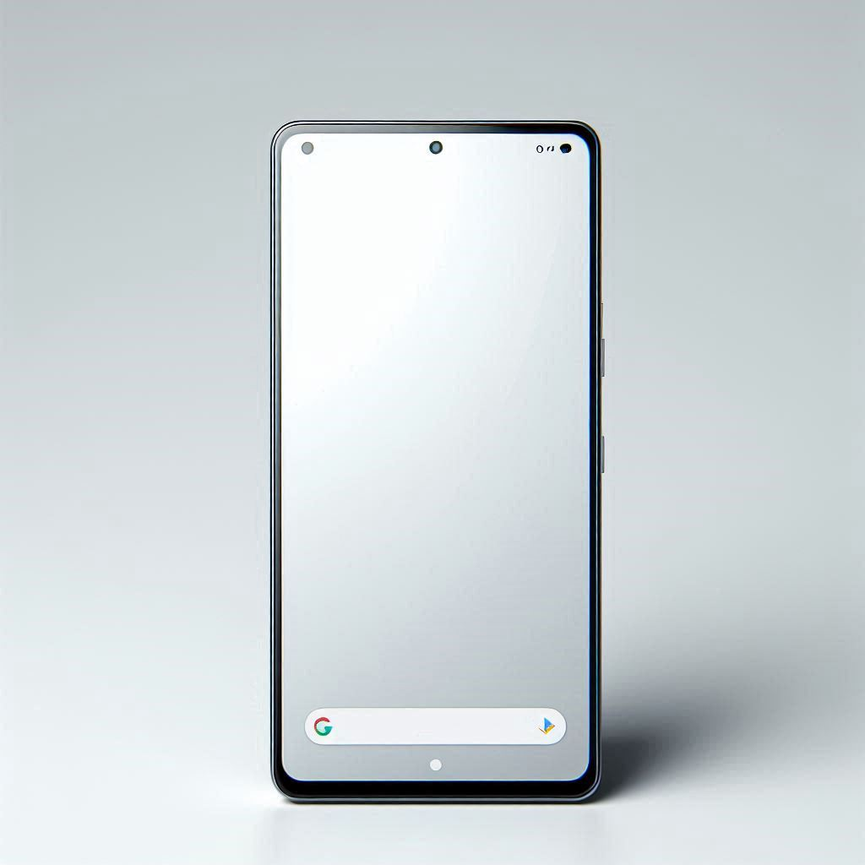


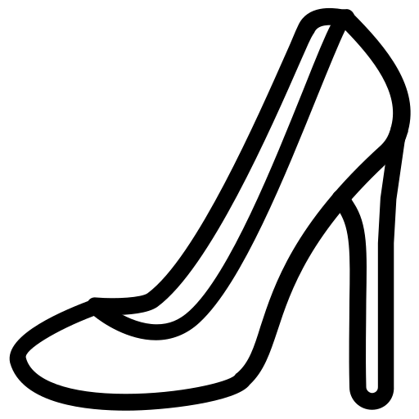

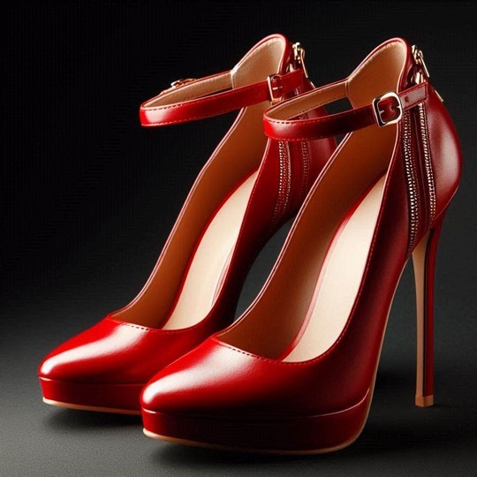
Categories
Most wanted
Closets
Designers
Less than $5k
Hi, Laurie!
I’m looking for some shoes for a night out
Your Feeds
Categories
Shopping Cart
Sell your items
Our locations
Blue high heel shoes by Kurt Geiger made with
More…
127
57
80% OFF + 18 MSI
HOT SALE ALERT !
UP TO
*Conditions apply
Red high heel shoes by Yves Saint Laurent with
More…
381
80

Slide 34
Deployment
Update data from every microservice to the client’s data
Shadow Deployment: Test out the prototype with dummy data and see that it behaves as expected. Human tests.
Canary Deployment: Start with a small fraction of traffic.
Blue/Green Deployment: Route customer traffic from old website to new website. Rollback is easy to do. Alternatively, have them both running in parallel but with different domains.

Slide 35
Automation
Most microservices can be fully automated, but there are others that may benefit from human intervention.
“Sell your items” microservice may take feedback from the user when the item’s metadata is generated. Having a human in the loop would turn this into partial automation.

Slide 36
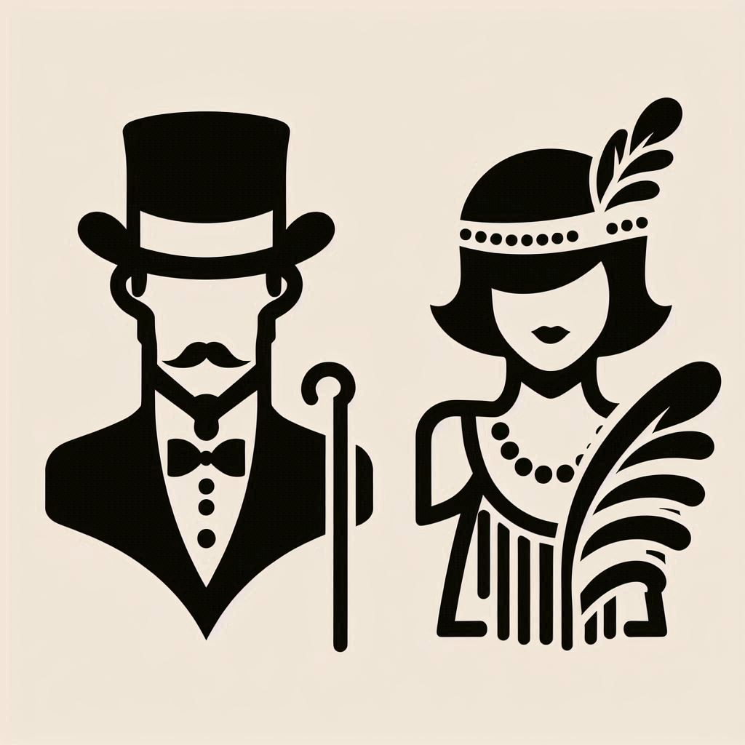

Slide 37

THE

Slide 38
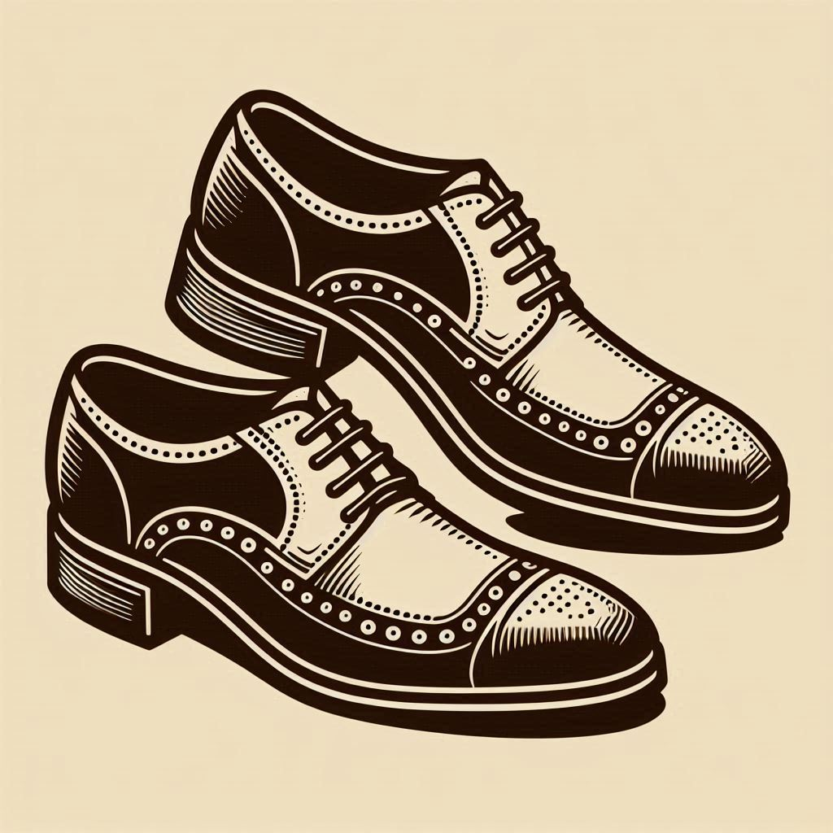
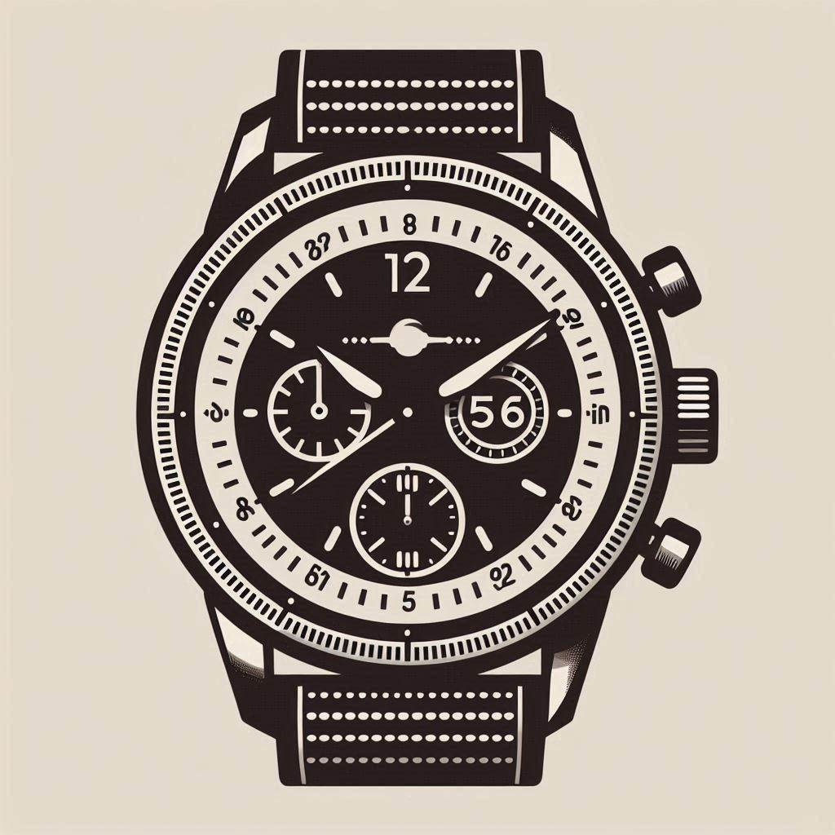


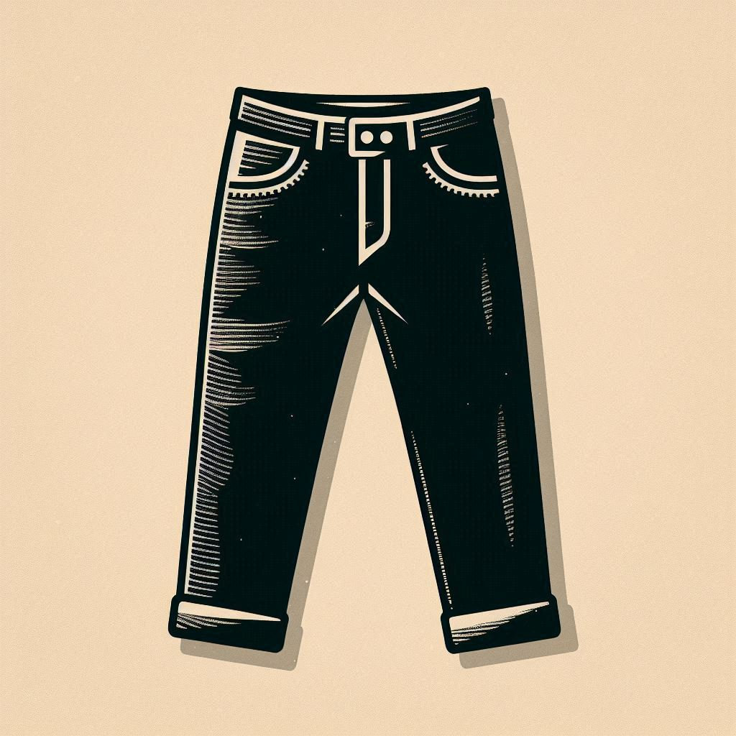


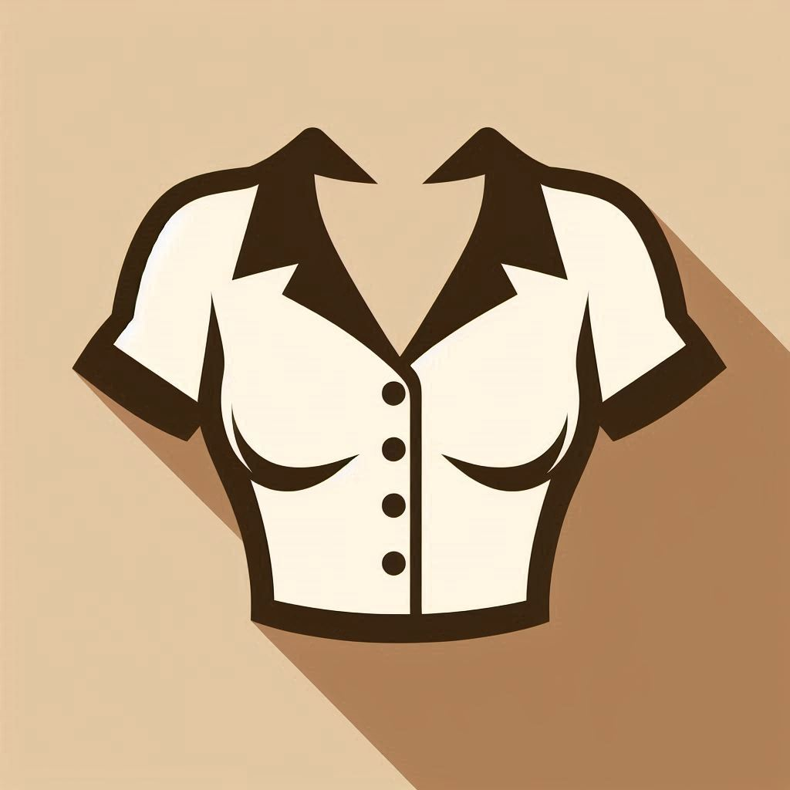
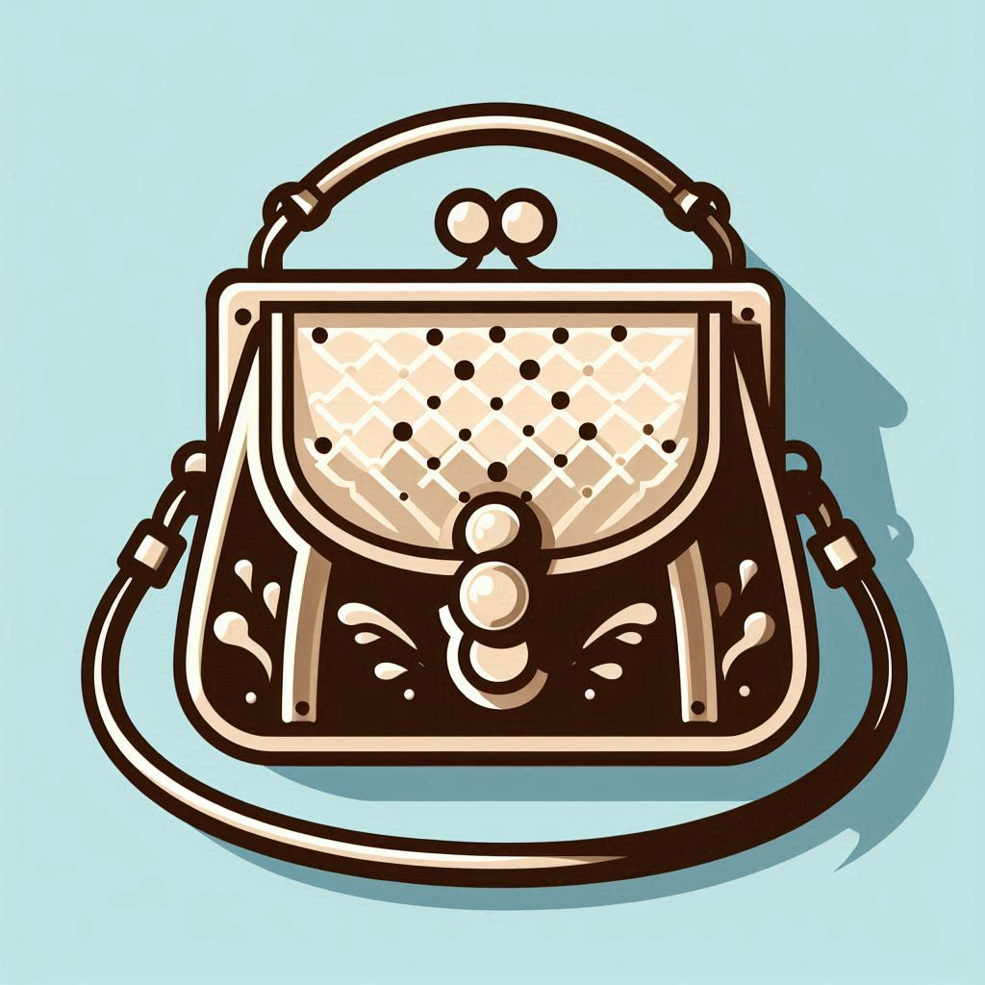
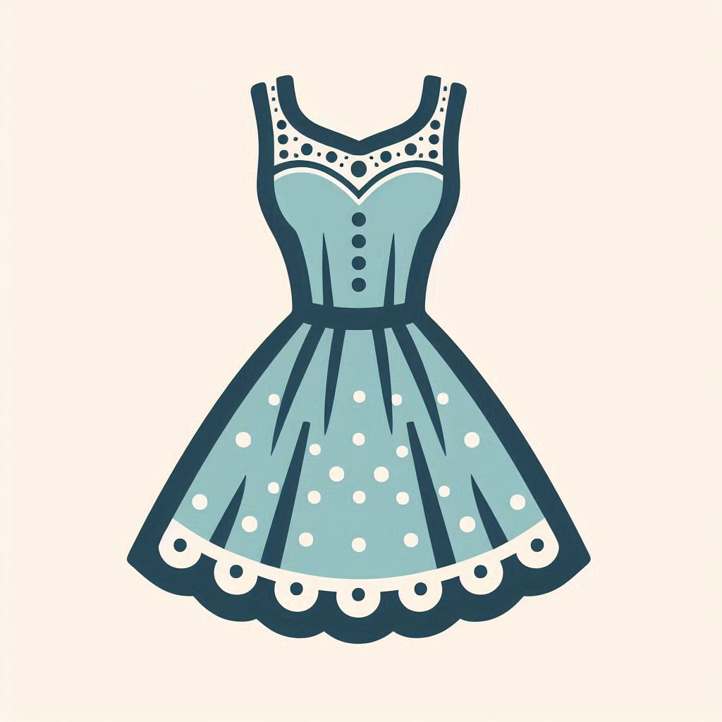
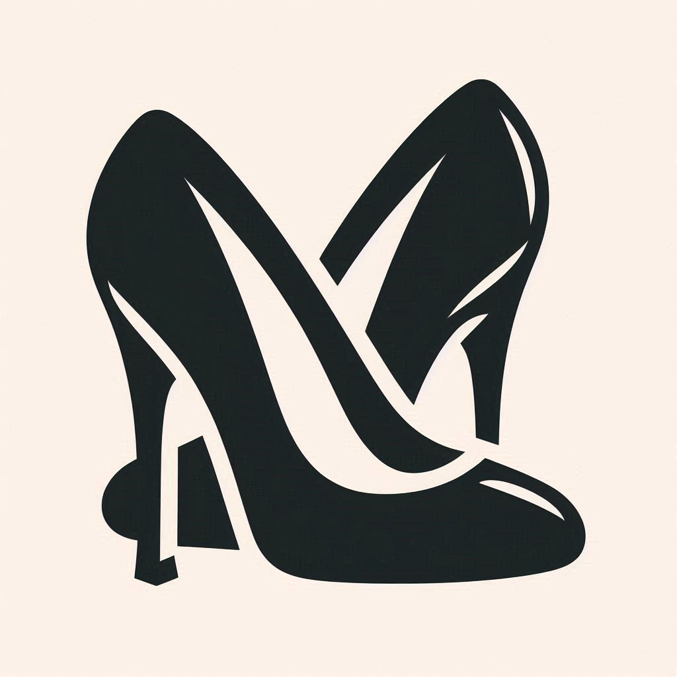
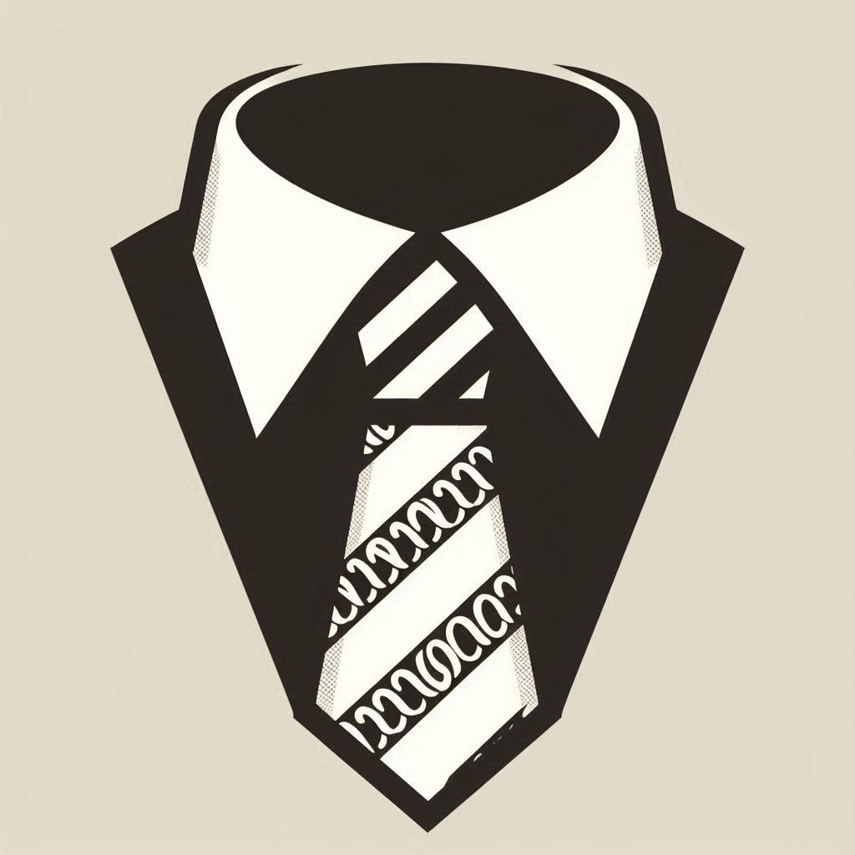

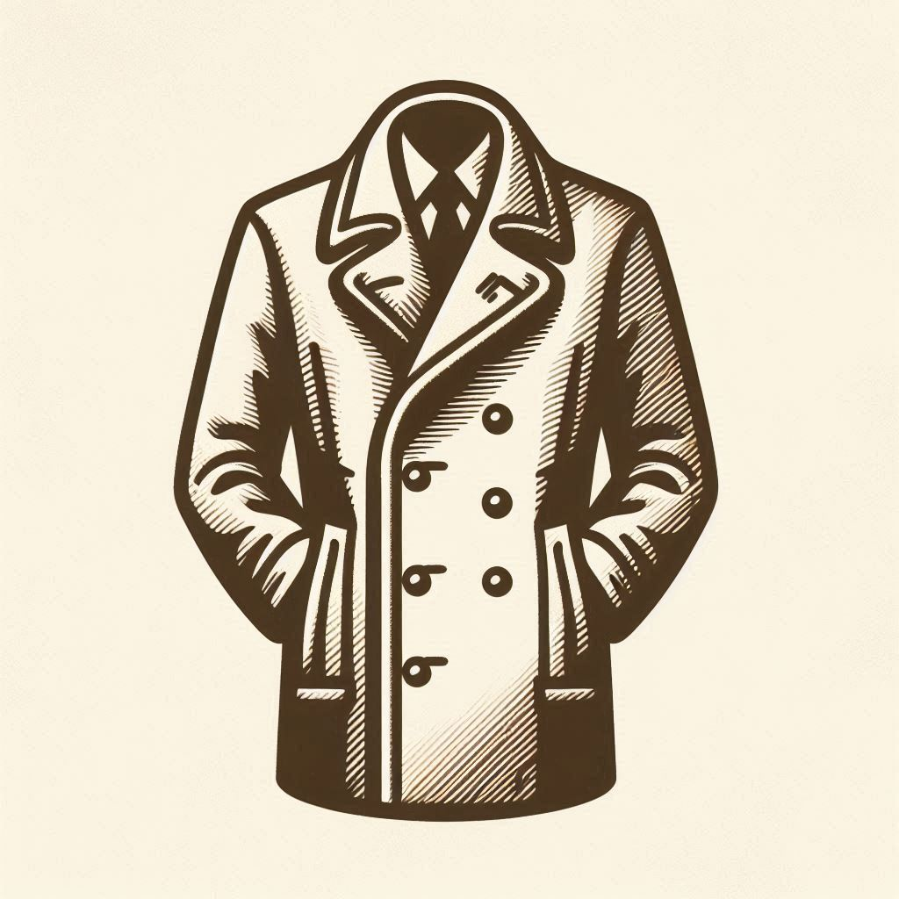
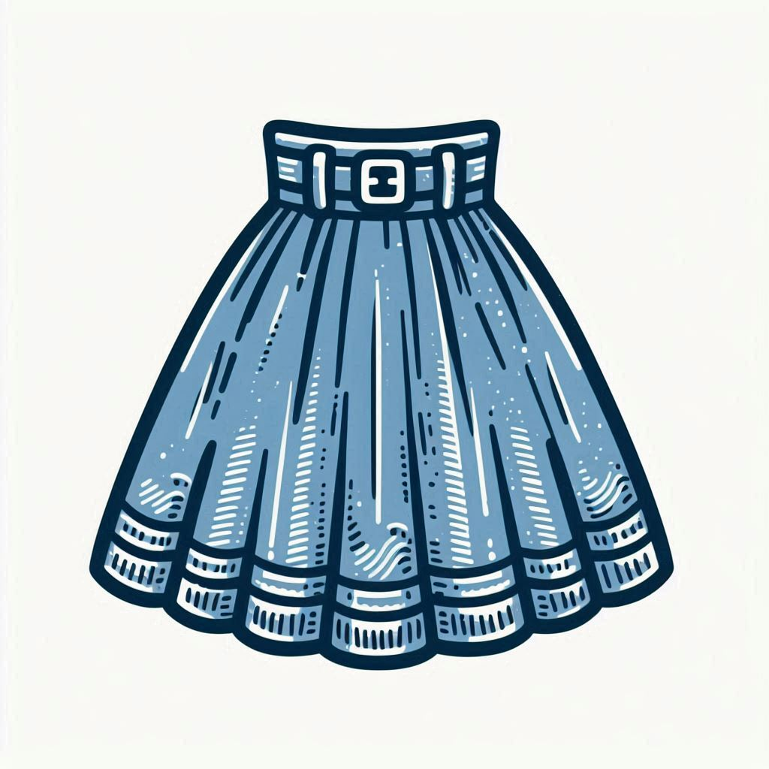

Slide 39
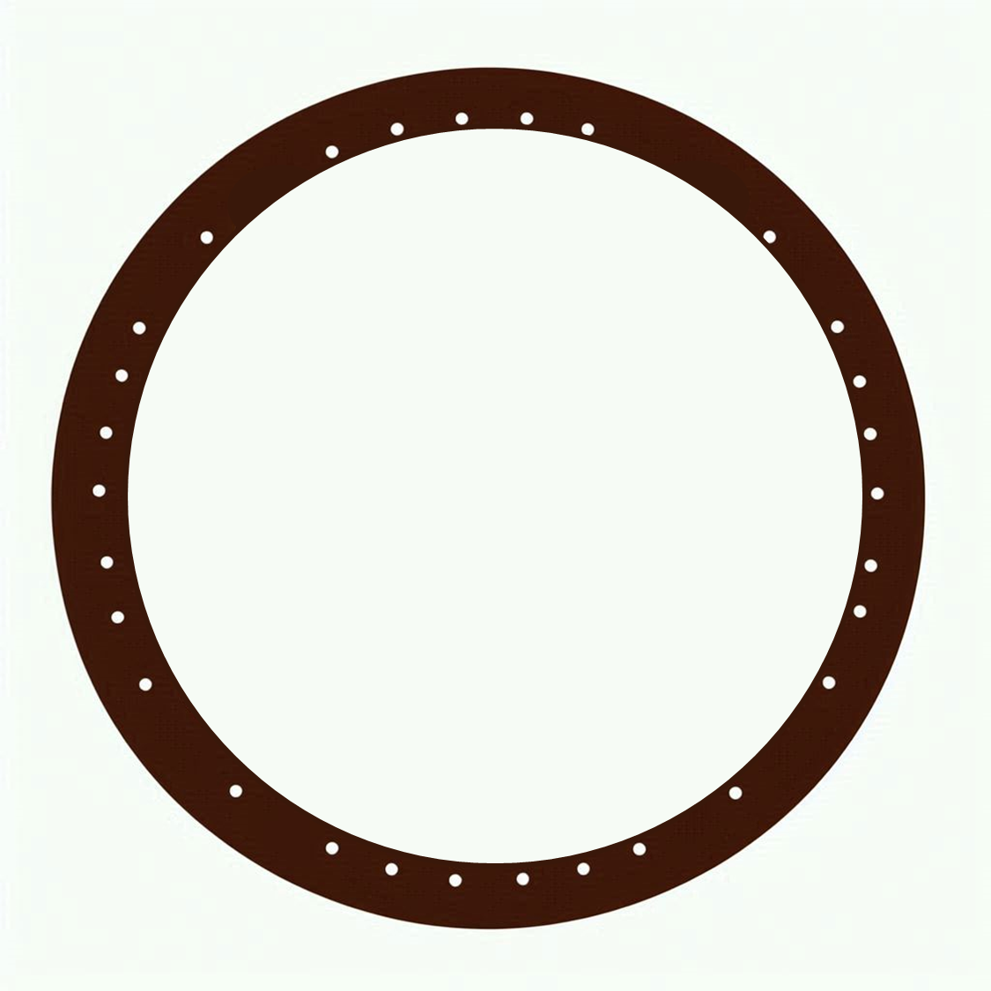

Slide 40



Slide 41
Ideas
Train an LLM to recognize Brands / Product Sizes?
Use automated Google Search to find brand icons and text logos
Use Gemini LLM to obtain information from clothing items.

Slide 42
Thank you!

